Slide 1

Immersive Technology Development
Lesson 0:
Module Introduction
Elyas Chua-Aziz
cel9@np.edu.sg
Diploma in IM
October 2021

Slide 2
Immersive Technology
Immersive Technology is any piece of technology that extends or creates reality.
This extended/new reality wraps around its users and makes one feel like they’re a part of a virtual world.
There are 3 primary Immersive Technologies being used today:
Augmented Reality (AR)
Virtual Reality (VR)
Mixed Reality (MR)

Slide 3
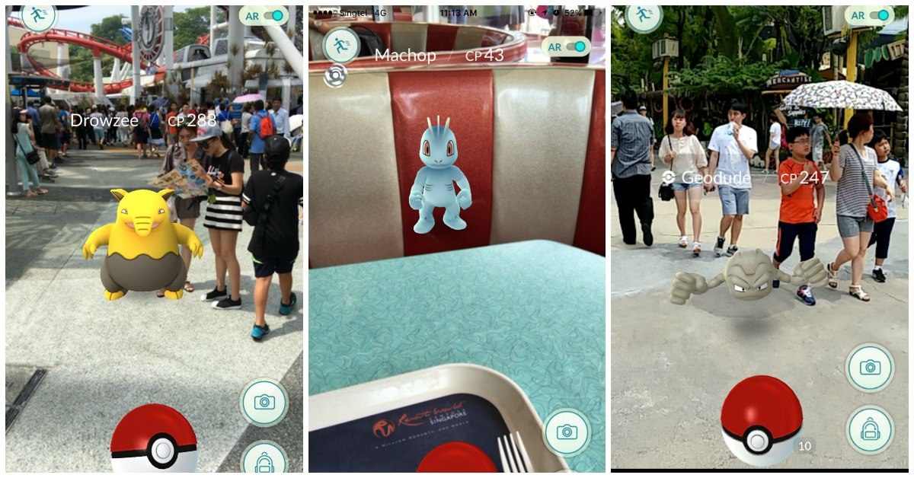
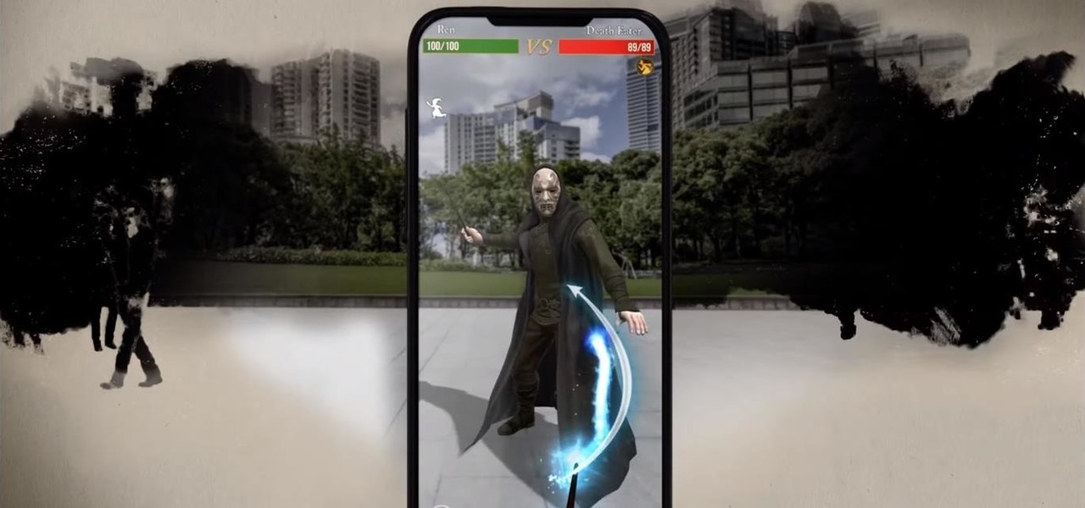
Augmented Reality (AR)
AR heightens immersion by extending the reality of its users.
It does so by overlaying digital information and data on to real world objects.

Slide 4
Augmented Reality (AR)
Aside from games, AR has a wide range of applications, from storytelling to training simulations, and even to shopping.

Slide 5
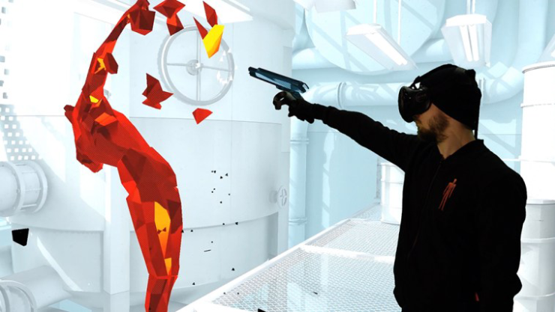
Virtual Reality (VR)
Rather than extending reality, VR increases immersion by creating a whole new reality and placing users in it.
This is achieved by having users wear a headset that blocks out the real world and displays only the virtual environment.

Slide 6
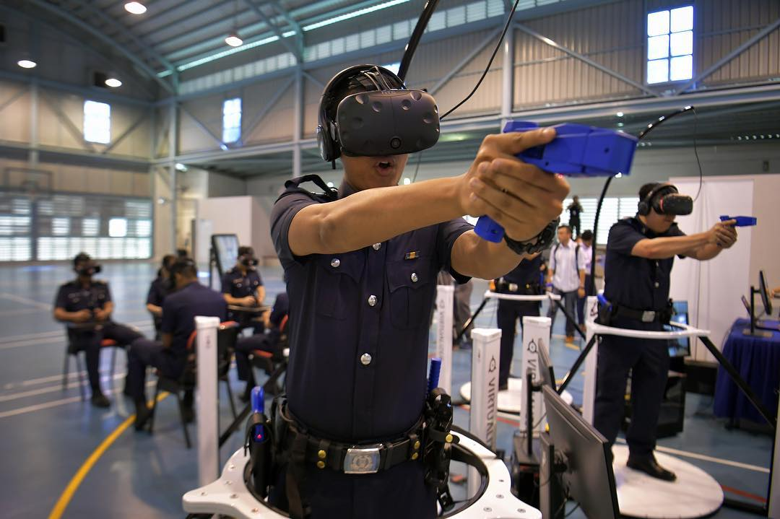
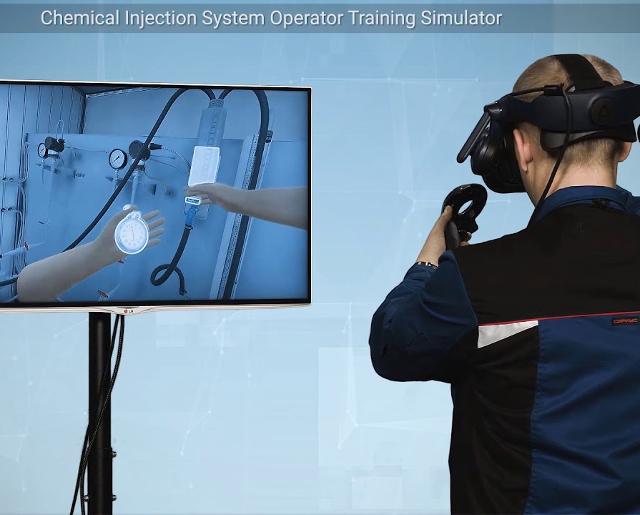
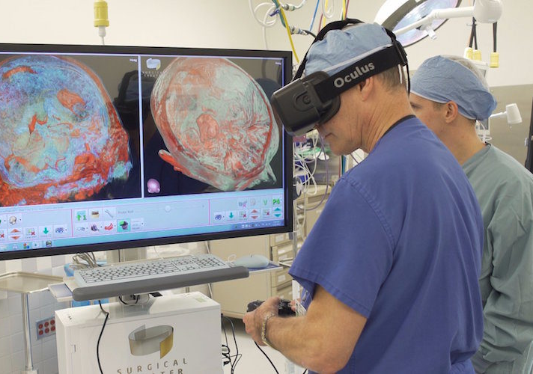
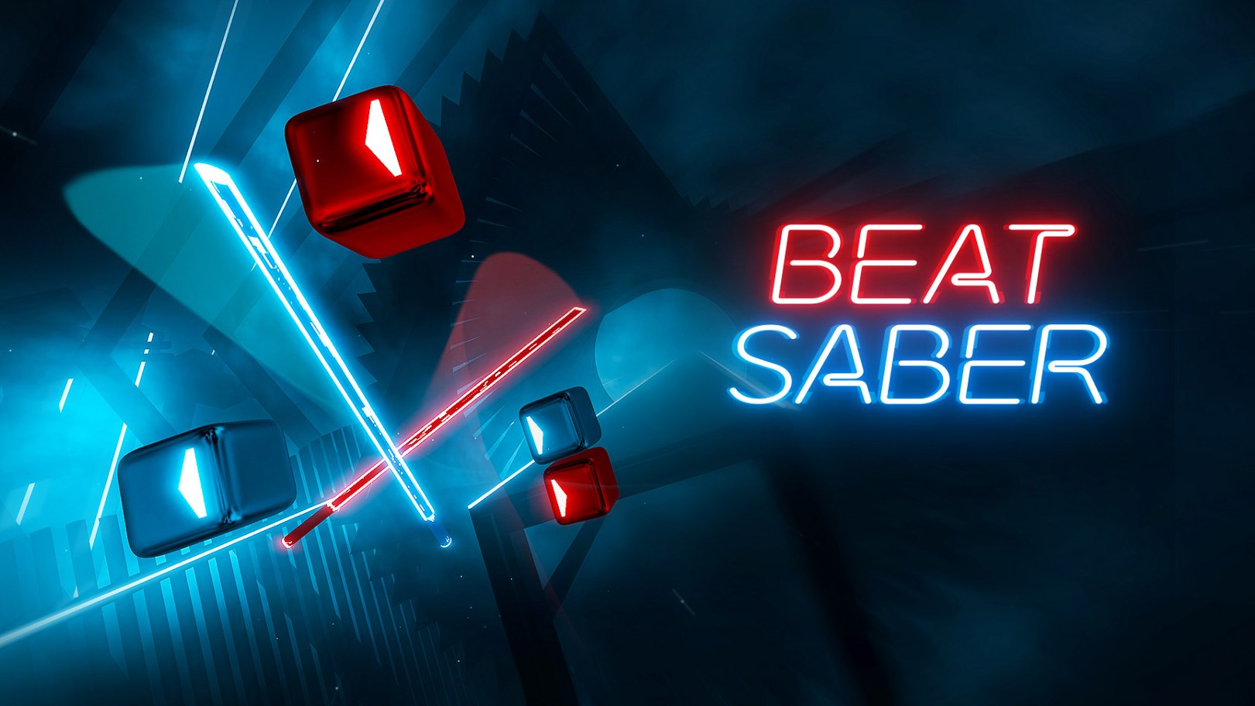
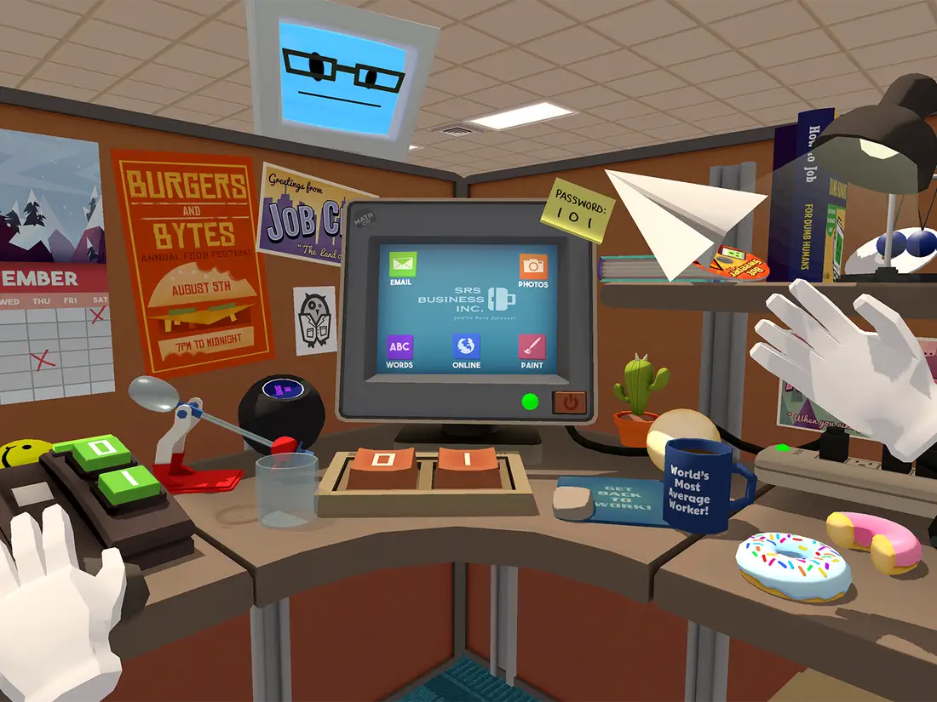
Virtual Reality (VR)
VR has seen extensive use in the gaming industry, with prominent titles being Beat Saber and Job Simulator.
Additonally, it has begun to see use in the field of training as well.

Slide 7
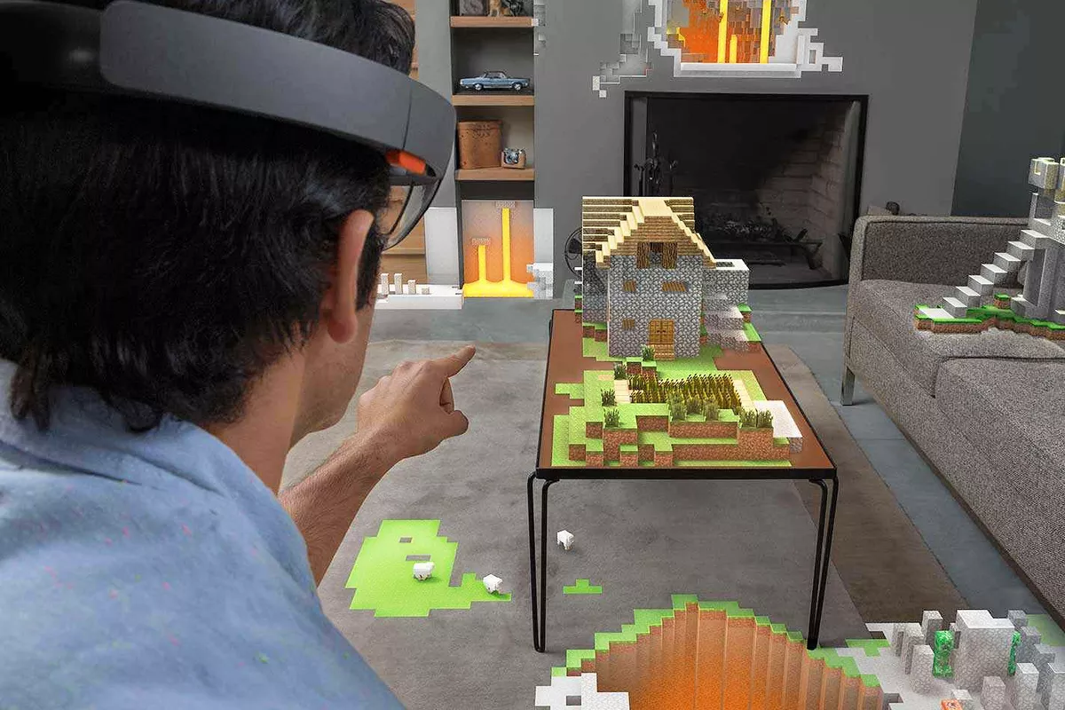
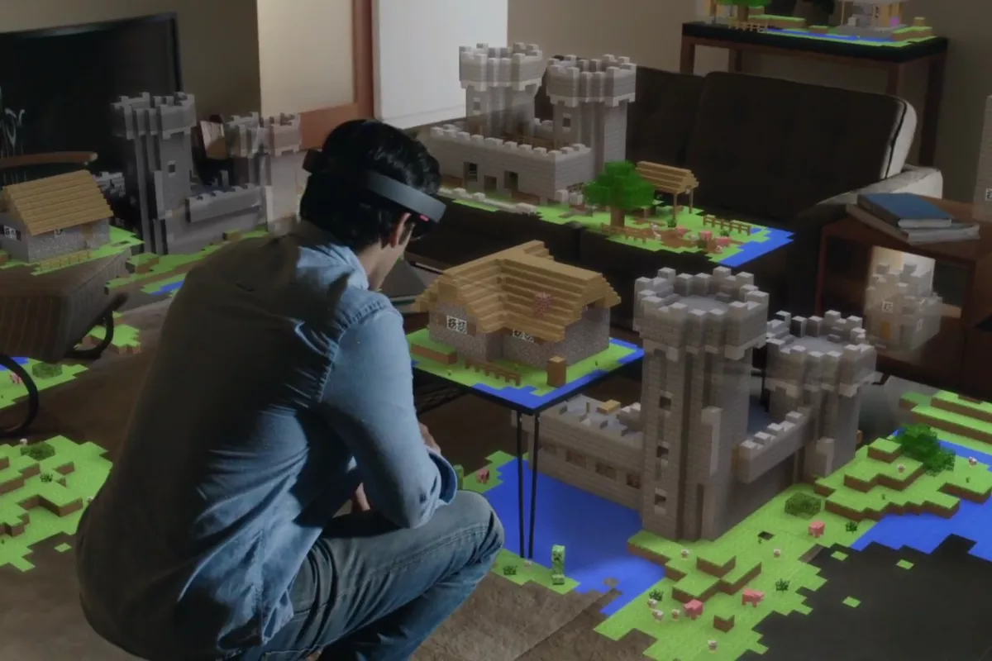
Mixed Reality (MR)
MR aims to combine the technologies of AR and VR by having digital and real-world objects co-exist and be able to interact with one another.
This also means that users will be able to interact with the digital world without additional controllers.

Slide 8
ITD Module
In the ITD module, we will look at how to create applications for these technologies in Unity.
We will also talk about some of the design considerations that need to be observed when creating immersive applications.

Slide 9
Timeline
Week | Topic(s) | Assessment(s)
1 | Module Introduction | CA1
 | Setting up Dev Environment
 | Tracking Image Targets
 | GitHub Desktop setup
2 | Custom Image Targets & Multiple Targets | Asg1 AR CA1
 | Placing 3D Objects in AR
3 | Interacting with 3D Objects in AR
 | Settling Conflicts with Git
4 | Other forms of AR Tracking (Smart Terrain, Text Recognition, Model Targets)
 | UI for AR
5 | Consultation
6 | Setting up Unity cloud database plugin | Asg2 VR CA2
 | Accessing cloud database with Unity
 | Creating new Branches and Merging Branches with Git
7 | VR Introduction
 | Setting up Dev Environment
 | Basic Interactions
8 | UI for VR
 | Movement for VR
9 | Consultation

Slide 10
Timeline
Week | Topic(s) | Assessment(s)
10 | TERM BREAK
11
12 | HelloHolo MR Lessons | MR CA
13
14 | Consultation | Asg3 IP CA3
15 | Consultation
16 | Consultation
17 | Consultation
18
19 |  | VIVA
Timeline is tight, but the earlier assignments will serve more as a ‘taster’.
More in-depth exploration will come in the IP assignment.

Slide 11
Assessment
Assignments:
Assignment 1 (20%)
Pair
Basic AR Application
Assignment 2 (20%)
Group
VR Application
Assignment 3 (30%)
Group
Your choice of Immersive Technology
AR, VR, MR
CA:
CA1 (2%)
CA2 (3%)
CA3 (5%)
Mixed Reality CA + Unity Certification Test (10%)
Technical Documentation (10%)
Inclusion of XML comments, file headers for all submitted work

Slide 12
Software
Unity 2020.3.20f
Visual Studio
GitHub Desktop

Slide 13
Ground Rules
Have your software open before lesson starts
Don’t be afraid to ask questions about the material

